Slide 1
Module 1: European regulations on procedural rights of suspects at the investigative stage
Co-funded by the Justice Programme (2014-2020) of the
European Union
“This publication was funded by the European Union’s Justice Programme (2014-2020). The content of this training material represents only the views of the Netpralat’s Project Partners and is their sole responsibility. The European Commission does not accept any responsibility for use that may be made of the information it contains."

Slide 2
Welcome
Welcome to the Module on European regulations on suspects’ procedural rights at the police detention stage. This module covers the EU Directives on suspects’ procedural rights and the respective ECtHR case law. Practicing lawyers may use the European regulations to conduct litigation before the ECtHR and the Court of Justice of the EU; rely on them in pleadings before domestic courts both at trial and pre-trial stages; and use them as guidance to determine what to do in problematic situations arising at the police station.
Next

Slide 3
Welcome
This module focuses on the numerous human rights’ standards and EU Directives which apply in the police station context. One of the central Directives in this context is the Directive on the right of access to a lawyer.
Two other Directives are important in the police station: the Directive on the right to information, and the Directive on the right to interpretation and translation.
This Module contains several hypothetical scenarios with questions to which you have to respond. The scenarios take place in a fictitious European country Freelandia, is which all Directives apply. This was purposefully done to encourage you to focus on the principles of the Directives and develop that knowledge before we move on and consider the national position in the following Modules.
Introduction

Slide 4
Introduction
Module Aims & Topics Covered
learn about the content of the EU Directives on suspects’ procedural rights and relevant ECtHR case law as they apply at the police detention stage;
learn to apply the principles derived from the Directives and the respective ECtHR case law to hypothetical situations arising at the stage of police detention;
become aware of how norms and principles derived from the relevant European law and jurisprudence may guide lawyer’s choices of professional behavior when assisting clients in police custody.
Homepage

Slide 5
Homepage
Click HOME to return to this homepage
Click on the boxes to open the respective parts
Part 1: Arrest and detention
Partl 2: The arrival of the lawyer
Part 3:
The lawyer-client consultation
Part 4: The interview
Summary

Slide 6
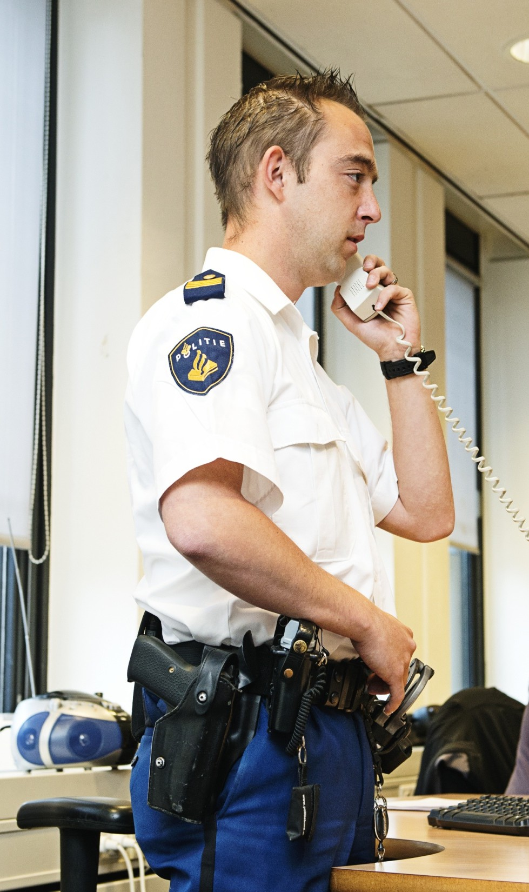
Part 1: Arrest and detention
CLICK on this icon to come back to this slide
When a suspect is arrested and brought to the police station, the following procedural rights are usually at stake:
Click on the boxes below to reveal more information.
Right to be informed about the rights
Right to be informed about the accusation
Access to a lawyer
The choice of a lawyer
Scenario
Right to interpretation

Slide 7
The right to be informed about procedural
rights
Articles 3 and 4 of the Directive on the Right to Information.
According to the Directive, suspects must be provided promptly, and in any case before the first official questioning, with information about at least the following procedural rights:
Click on the numbers below for more information.
1 2 3 4 5
The manner of informing
Letter of Rights

Slide 8
The right to be informed about procedural
rights
Articles 3 and 4 of the Directive on the Right to Information.
According to the Directive, suspects must be provided promptly, and in any case before the first official questioning, with information about at least the following procedural rights:
The right of access to a lawyer
Click on the numbers below for more information.
1 2 3 4 5
The manner of informing
Letter of Rights

Slide 9
The right to be informed about procedural
rights
Articles 3 and 4 of the Directive on the Right to Information.
According to the Directive, suspects must be provided promptly, and in any case before the first official questioning, with information about at least the following procedural rights:
Click on the numbers below for more information.
1 2 3 4 5
The right to free legal aid
The manner of informing
Letter of Rights

Slide 10
The right to be informed about procedural
rights
Articles 3 and 4 of the Directive on the Right to Information.
According to the Directive, suspects must be provided promptly, and in any case before the first official questioning, with information about at least the following procedural rights:
Click on the numbers below for more information.
1 2 3 4 5
The right to be informed about the accusation
The manner of informing
Letter of Rights

Slide 11
The right to be informed about procedural
rights
Articles 3 and 4 of the Directive on the Right to Information.
According to the Directive, suspects must be provided promptly, and in any case before the first official questioning, with information about at least the following procedural rights:
Click on the numbers below for more information.
1 2 3 4 5
The manner of informing
The right to remain silent
Letter of Rights

Slide 12
The right to be informed about procedural
rights
Articles 3 and 4 of the Directive on the Right to Information.
According to the Directive, suspects must be provided promptly, and in any case before the first official questioning, with information about at least the following procedural rights:
Click on the numbers below for more information.
1 2 3 4 5
The right to translation and interpretation
The manner of informing
Letter of Rights

Slide 13
The right to be informed about procedural
rights
Articles 3 and 4 of the Directive on the Right to Information.
According to the Directive, suspects must be provided promptly, and in any case before the first official questioning, with information about at least the following procedural rights:
Click on the numbers below for more information.
1 2 3 4 5
The information may be provided orally or in writing, in a language, which the suspect understands. It must be provided in simple and
The
accessible language.
manner of informing about the rights must take account of the particular needs of the vulnerable suspects.
The manner of informing
Letter of Rights

Slide 14
The right to be informed about procedural
rights
Articles 3 and 4 of the Directive on the Right to Information.
According to the Directive, suspects must be provided promptly, and in any case before the first official questioning, with information about at least the following procedural rights:
Click on the numbers below for more information.
1 2 3 4 5
Ar r e ste d suspe c ts m u s t additionally be informed by a written Letter of Rights , containing information about the right of access to the case materials, to have consular authorities and one person close to the suspect informed about the arrest, the right of access to medical assistance, the right to challenge the lawfulness, or obtain the review of the detention, as well as the maximum period of deprivation of liberty before being produced to a judicial authority.
The manner of informing
Letter of Rights

Slide 15
The right to information about the accusation
Article 6 of the European Directive on the Right to Information
The information should be given at the latest before the first official interrogation. It must be sufficiently detailed to ensure the fairness of the proceedings and the rights of the defence, taking into account the procedural stage at which it is given.
At the outset of the proceedings, the information should include, as the minimum:
1 2

Slide 16
The right to information about the accusation
the factual description of the crime, for example, the circumstances, time and place of the suspected offence
the possible legal qualification of the offence. The information about the legal qualification must be sufficiently concrete. For example, simple theft is the crime of a different gravity than theft with violence committed in co-perpetration.
1 2

Slide 17
The right to informatio about the accusation
if a person is arrested, he must be informed of the grounds for arrest, meaning exactly in connection with which offence, or offences, they have been arrested.
1 2

Slide 18
Access to a lawyer
Directive on the Right of Access to a Lawyer Article 3:
states that access to a lawyer must be provided:
before any questioning
before any investigative act conducted with the suspect’s participation, e.g. an identification parade, confrontation, crime scene reconstruction
where a suspect is arrested, without undue delay from the moment of the deprivation of liberty. (In practice, soon after the suspect’s arrival to the police station).
Exceptions to the right of access to a lawyer
Ibrahim and others v. the United Kingdom
CLICk on the buttons on the right-hand side

Slide 19
Exceptions to the right of access to a lawyer
What are the exceptions to the right of access to a lawyer?
Exceptions to the right of access to a lawyer before any questioning and upon the deprivation of liberty are:
CLICK on the numbers below
1 2 3 4
Return to ’Access to a lawyer”

Slide 20
Exceptions to the right of access to a lawyer
What are the exceptions to the right of access to a lawyer?
Safety interviews to identify the person or to verify the possession of weapons and other dangerous items.
Geographical remoteness: for example, if proceedings take place during an overseas military operation. In that case the authorities must delay questioning or investigation until the lawyer is available.
1 2 3 4
Return to ‘Access to a lawyer’

Slide 21
Exceptions to the right of access to a lawyer
What are the exceptions to the right of access to a lawyer?
* Questioning suspect to avert serious harm to the life, liberty or physical integrity of the person, or the so-called “ticking bomb” scenario. The interview should aim solely at obtaining information necessary to prevent serious harm to persons.
1 2 3 4
Return to “Access to a lawyer”

Slide 22
Exceptions to the right of access to a lawyer
What are the exceptions to the right of access to a lawyer?
Where immediate questioning is needed to prevent “substantial jeopardy to criminal proceedings, in particular “to prevent destruction or alteration of essential evidence, or to prevent interference with witnesses.” Such questioning may aim solely at obtaining information essential to prevent prejudice to the proceedings.
1 2 3 4
Return to ‘Access to a lawyer’

Slide 23
Exceptions to the right of access to a lawyer
What are the exceptions to the right of access to a lawyer?
The last exception might potentially be interpreted very broadly. For example, the authorities could adopt a practice, where, if only one of several co-suspects is arrested, they would always question him immediately without waiting for a lawyer, because of the urgent need to arrest other co-suspects. Such blanket justification is insufficient. According to the Directive, any temporary delay of access to a lawyer must be accompanied with compelling reasons and justified by reference to the particular case circumstances. So, as a minimum, the authorities must show that in the given case, there is a real risk of interference with witnesses or evidence, if access to a lawyer was not delayed.
1 2 3 4
Return to “Access to a lawyer’

Slide 24
Ibrahim and others v. United Kingdom
The ECtHR found in Ibrahim and others v. UK that information obtained from the suspect during questioning, which falls under one of the above-mentioned exceptions, may be used for conviction, provided that the proceedings on the whole were fair. This finding was criticised by the dissenting judges.

Slide 25
The choice of a lawyer
Click on the points below for more information
The right to choose a lawyer is mentioned in Art. 6 (3) (c) ECHR. The Dvorski v Croatia case covers the right at police detention stage. Dvorski clarifies that the right applies both to privately-paying and legally-aided suspects. In Dvorski, the police did not inform the suspect that his parents had hired a lawyer for him. Instead, they had asked whether Dvorski agreed to be assisted by a certain lawyer known to the police, to which Dvorski did not object.
The Court found that there were no relevant and sufficient reasons to restrict Dvorski’s right to choose a lawyer. The only reason cited by the authorities was that the lawyer chosen by his parents did not have a valid power of attorney, which was not true.
Which conclusions can be drawn from the Dvoski v. Croatia case?

Slide 26
The choice of a lawyer
Click on the points below for more information
Firstly, the right to choose a lawyer may be restricted, but there should be a valid reason for doing so. For example, where the lawyer is not covered by the legal aid scheme, and the suspect has no means to pay him, or where the lawyer is not sufficiently qualified.

Slide 27
The choice of a lawyer
Click on the points below for more information
Secondly, suspects should be able to choose a lawyer on an informed basis.
Any waiver of the right to choose a lawyer must be voluntary and informed. The waiver would not be valid, where the police tell the suspect that their chosen lawyer is not available, without trying to contact this lawyer first. Also, it would probably not be valid, where suspects are told that if they choose their own lawyer, they would have to wait longer in detention for the lawyer to arrive.

Slide 28
The choice of a lawyer
Click on the points below for more information
The right to choose a lawyer implies positive obligations on the authorities’ behalf. For example, to inform the suspect that third parties have engaged a lawyer to represent them as in the Dvorski case, or to inform the suspect whether and when their chosen lawyer is available to attend.

Slide 29
The right to interpretation
Click on the points below for more information
The right to interpretation is codified by the Directive on the Right to Interpretation and Translation.
Interpretation should be provided from the moment the person is made aware about the criminal suspicion. It should in principle be provided promptly, although a delay may be longer, for instance, where a suspect speaks a rare language. In any case, interpretation should be available during police questioning.

Slide 30
The right to interpretation
Click on the points below for more information
There must be a mechanism to assess whether the suspect speaks or understands the language of the proceedings, and if not, then which language they are proficient in. This assessment should be performed in every case of doubt as to whether the suspect sufficiently masters the language of the proceedings.

Slide 31
The right to interpretation
Click on the points below for more information
Interpretation should be provided either in the native language of the suspect, or in the
language that the suspect speaks or understands.
The Directive does not say what level of knowledge is implied in the term “not being able to speak or understand the language of the proceedings”. In any case, suspects should be sufficiently fluent in the given language to enable them to fully exercise their rights of defence, and safeguard the fairness of the proceedings. Thus, even advanced speakers may be in need of interpretation, for example, if they are not familiar with the legal terms, or because their language skills may be affected by the stress of police custody.

Slide 32
The right to interpretation
Click on the points below for more information
It is not only the exchanges with the authorities that must be interpreted, but also the
suspects’ communication with the lawyer.

Slide 33
The right to interpretation
Click on the points below for more information
The interpretation must be of sufficient quality to ensure that suspects are fully able to exercise their defence rights and have knowledge about the case against them. Therefore, lawyers should be attentive to the signs of deficient quality of interpretation and make representations as to the quality of interpretation to the authorities.
To learn more about the lawyer’s role in respect of the right to interpretation, see
Resources (FTI Toolkit Right to Interpretation; Right to Interpretation and Information (Inside Police Custody)).

Slide 34
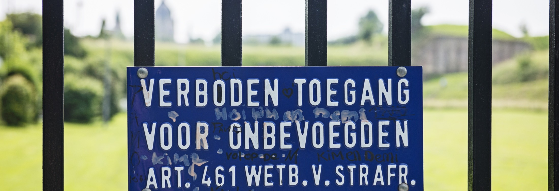
Arrest and detention
Read the case facts, watch the video and respond to the QUESTIONS
Jacques is 22 years old, he is a foreign citizen, and is in Freelandia on a holiday. He was seen taking a plastic bag with pills that looked like exctasy from Peter, a co-suspect, at the State of the Trance concert. When approached by the police Jacques started waiving his hands and screaming (in his native language): “Get your hands off me!” He was arrested for resistance to arrest and possession of drugs.
CLICK below to watch the video
Jacques was taken to the police station. He was searched and placed in an interview room. A few minutes later a police officer came in. She spoke with him in English (not Jacques’ native language).
QUESTIONS

Slide 35
Questions on the Scenario:
1
2
3
4
5
6
7
8
9
10
Arrest
(CLICK on the numbers on the left-hand side)

Slide 36
Is the right of access to a lawyer violated?
1
2
3
4
5
6
7
8
9
10

Slide 37
1
2
3
4
5
6
7
8
9
10
The right of access to a lawyer was not violated, because the police officer decided to invite a (duty) lawyer to Jacques, even though his response may have been interpreted as an
implicit waiver of the right.

Slide 38
Is the right to choose a lawyer violated?
1
2
3
4
5
6
7
8
9
10

Slide 39
1
2
3
4
5
6
7
8
9
10
The right to choose a lawyer was possibly violated (if, indeed, Jacques had a lawyer of his choice). To ascertain this, the officer should have informed Jacques about the right to choose a lawyer, and asked him whether he wants to be assisted by a particular lawyer.

Slide 40
Was Jacques adequately informed about the accusation?
1
2
3
4
5
6
7
8
9
10

Slide 41
1
2
3
4
5
6
7
8
9
10
The officer did not inform Jacques properly about the accusation. Jacques was not informed about the nature of the drug charge, and only generally about the charge of resisting arrest. He was not informed about the details of the suspected offences. He was also not informed that there was a co-suspect in his case (Peter). Jacques was also possibly not informed in the language he understands.

Slide 42
Is the right to be informed about the rights violated?
1
2
3
4
5
6
7
8
9
10

Slide 43
1
2
3
4
5
6
7
8
9
10
The right to information about the rights was violated. Jacques was not informed about the right to information about the accusation, and the right to interpretation and translation. Jacques was also not given the written Letter of Rights. He was also possibly not informed about the rights in the language that he understands.

Slide 44
Is the right to interpretation violated?
1
2
3
4
5
6
7
8
9
10

Slide 45
1
2
3
4
5
6
7
8
9
10
The right to interpretation was possibly violated in this case. There were indications that Jacques may not have understood the information about the accusation and the rights, because he did not sufficiently speak or understand the language used by the officer. In that case, an assessment of the need for interpretation should have been made.
Return to the homepage

Slide 46
Part 2: The arrival of the lawyer
CLICK on this icon to return to this page
In this part of the Module we deal with the following procedural rights:
Click on the buttons below for more information.
Access to the file/evidence
This part also deals with the right to choose a lawyer and the right to be informed about the accusation.
Return to Part 1
Scenario
Scenario

Slide 47
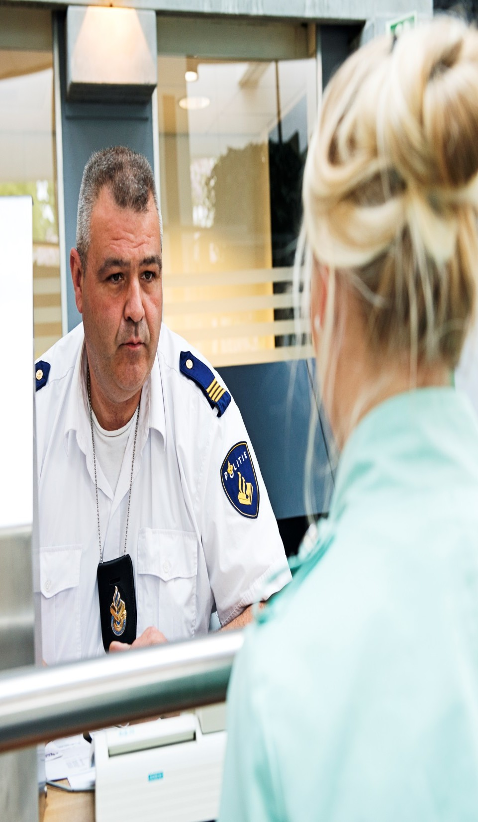
The right of access to a file/evidence
Directive on the Right of Access to Information Article 7: authorities should provide the suspect and her lawyer access to all material evidence on the case in a timely manner to allow for the effective exercise of the defence rights and safeguard the fairness of the proceedings.
From what moment in the proceedings does the right start to apply?
Click on the buttons below for more information
Directive on the right to information
A.T. v. Luxemburg
Further information

Slide 48
The right of access to a file/evidence
Directive on the Right of Access to Information Article 7: authorities should provide the suspect and her lawyer access to all material evidence on the case in a timely manner to allow for the effective exercise of the defence rights and safeguard the fairness of the proceedings.
From what moment in the proceedings does the right start to apply?
Click on the buttons below for more information
Partial access to the material evidence may have to be provided already at the early stages of the proceedings. For instance, the Directive requires that the documents and evidence that are essential for challenging effectively the lawfulness of the arrest or detention must be provided to arrested suspects and their lawyers in due time and “at the latest before a competent judicial authority is called upon to decide” on the lawfulness of arrest and detention. The “competent authority” may also be a prosecutor, or even a senior police officer acting under delegated powers.
Directive on the right to information
A.T. v. Luxemburg
Further information

Slide 49
The right of access to a file/evidence
Directive on the Right of Access to Information Article 7: authorities should provide the suspect and her lawyer access to all material evidence on the case in a timely manner to allow for the effective exercise of the defence rights and safeguard the fairness of the proceedings.
From what moment in the proceedings does the right start to apply?
Click on the buttons below for more information
In A.T. v. Luxembourg, the ECtHR had to consider whether the right of access to the case file already applies before the first official suspect interrogations.
The ECtHR ruled that the general right of access to the case file before the first interrogation of the suspect cannot be de duc te d fr om the Eur ope an Convention of Human Rights or from the Directive. There may be legitimate reasons to limit access to the evidence to the suspect at the very outset of the criminal proceedings.
Directive on the right to information
A.T. v. Luxemburg
Further information

Slide 50
The right of access to a file/evidence
Directive on the Right of Access to Information Article 7: authorities should provide the suspect and her lawyer access to all material evidence on the case in a timely manner to allow for the effective exercise of the defence rights and safeguard the fairness of the proceedings.
From what moment in the proceedings does the right start to apply?
Click on the buttons below for more information
The Directive mentions that the right of access to the case file may be limited for the reasons of protection of the rights of the third persons or the interests of the ongoing investigation,among others. The need to confront the suspect with certain evidence may be a legitimate reason to limit such access. At the same time, there is nothing that precludes the authorities to disclose evidence to the suspect or her lawyer, because it can move the investigation further along or save time in the interrogation.
Directive on the right to information
A.T. v. Luxemburg
Further information

Slide 51
The right of access to a file/evidence
Directive on the Right of Access to Information Article 7: authorities should provide the suspect and her lawyer access to all material evidence on the case in a timely manner to allow for the effective exercise of the defence rights and safeguard the fairness of the proceedings.
From what moment in the proceedings does the right start to apply?
Click on the buttons below for more information
Directive on the right to information
A.T. v. Luxemburg
Further information

Slide 52
The arrival of the lawyer
Read the fact, the additional information, and then respond to QUESTIONS.
Duty lawyer M. arrives to attend on Jacques at 2 a.m. An officer asks her to see Peter, the co-suspect of Jacques, as well. Note: under Freelandian law, a review of detention must take place six hours after arrest.
Click on the i c o n f o r addi ti onal information
Peter is suspected of possession of drugs and drug dealing. He was seen passing a plastic bag with pills looking like ecstasy to Jacques by two witnesses, both police informants. Peter has a criminal record of drug dealing. Peter asked for a lawyer Mr. B., who was not available to attend until 11 a.m.
QUESTIONS

Slide 53
The arrival of the lawyer
Police wished to interrogate Peter “first thing in the morning”, so maybe lawyer M. could see him “to speed up things”.
Lawyer M. agrees and decides to see Jacques first. The lawyer then asks the officer:
Read t
- Can you tell me more about Jacques? Why was he arrested? What’s the evidence?
he fact, the additional information, and then respond to QUESTIONS.
rrives to attend on Jacques at 2 a.m. An officer asks her to see
spect of Jacques, as well. Note: under Freelandian law, a _{Click on the}
on must take place six hours after arrest. i c o n f o r
addi ti onal ed of possession of drugs and drug dealing. He was seen information
^{Duty lawyer M. a} The officer responds:
Peter, the co-su
^{review of detenti} - He had two ecstasy pills on him. I can say no more. Be careful with him, he _{Peter is suspect} was violent at arrest.
passing a plastic bag with pills looking like ecstasy to Jacques by two witnesses, both police informants. Peter has a criminal record of drug dealing. Peter asked for a lawyer Mr. B., who was not available to attend until 11 a.m.
QUESTIONS

Slide 54
Questions to the Scenario: The
1
2
3
4
5
6
7
8
9
10
lawyer’s arrival
(CLICK on the numbers on the left-hand side)

Slide 55
Was the right to choose a lawyer violated?
1
2
3
4
5
6
7
8
9
10

Slide 56
1
2
3
4
5
6
7
8
9
10
The right to choose a lawyer was violated. The reason for overriding Peter’s choice of the lawyer cited by the officer – the wish to proceed quicker to the interrogation – is not “relevant and sufficient.” The chosen lawyer confirmed that he was available to attend Peter, and there is no reason to believe that the interests of the investigation required that Peter’s interrogation was conducted urgently.

Slide 57
Was the right of access to the file/evidence violated?
1
2
3
4
5
6
7
8
9
10

Slide 58
1
2
3
4
5
6
7
8
9
10
The right was possibly violated. It may be inferred from the scenario that Peter was arrested well before 2 am, and will be interrogated in the morning. Thus, the detention review according to Freelandian law would take place the same night, before Peter’s interrogation. If such review is undertaken by a “judicial authority”, the lawyer (and the suspect) must be informed about the evidence, which served as the basis for the arrest, before the review takes place.

Slide 59
Was the lawyer adequately informed about the accusation against his client?
1
2
3
4
5
6
7
8
9
10

Slide 60
The lawyer was not provided with adequate information about the accusation. He was not informed about the nature and legal qualification of the charges, nor about the details of the suspected offences.
1
2
3
4
5
6
7
8
9
10

Slide 61
Officer: “Could you also attend Peter? I called the firm of his preferred lawyer, but he can only attend at 11 am. And we’d like to interrogate Peter early in the morning?”
1
2
3
4
5
6
7
8
9
10
What could the lawyer respond to the officer?

Slide 62
“I prefer not too see Peter, as he is co-suspect of my client Jacques. Can the interrogation be postponed until Peter’s lawyer becomes available?”
The lawyer acknowledges Peter’s right to choose a lawyer. She also recognises the risk of conflict of interest between Jacques and Peter. If Jacques wished to admit that Peter sold drugs to him, the lawyer could not represent Peter, if he wanted to deny the charges.
1
2
3
4
5
6
7
8
9
10

Slide 63
The custody officer responded to lawyer’s question about the nature of the accusation: “He had drugs on him. I can say no more. He was violent upon arrest.”
1
2
3
4
5
6
7
8
9
10
What could the lawyer have responded to this?

Slide 64
“Thank you officer, but I need more information to assist my client effectively. How can I reach the officer in charge?”
The lawyer tries to obtain more case-related information, arguing by reference to her professional role. The officer in charge is likely to have the best overview of the evidence and other information about the case and the client.
1
2
3
4
5
6
7
8
9
10
Return to homepage

Slide 65
Part 3: Consultation
CLICK here to return to this silde
In part 3 of the module we deal with the following procedural rights:
Click on the buttons below for more information.
Adequate time and facilities
The right to have a lawyer present at interrogation
We also deal with the right to interpretation, which is discussed in Part 1.
Scenario
Return to Part 1

Slide 66
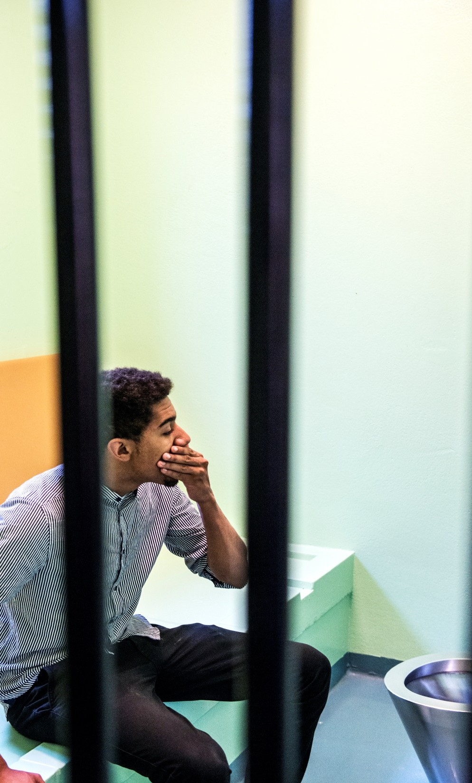
The right to adequate time and facilities for the
preparation of the defence
Right to adequate time and facilities: Article 6 (3) (b) of the European Convention on Human Rights.
The right consists of a number of elements, distinguished in the case law of the European Court of Human Rights:
CLICK on the numbers below.
1 2 3 4

Slide 67
The right to adequate time and facilities for the
preparation of the defence
Right to adequate time and facilities: Article 6 (3) (b) of the European Convention on Human Rights.
The right consists of a number of elements, distinguished in the case law of the European Court of Human Rights:
CLICK on the numbers below.
1 2 3 4
The right to be informed about the accusation.

Slide 68
The right to adequate time and facilities for the
preparation of the defence
Right to adequate time and facilities: Article 6 (3) (b) of the European Convention on Human Rights.
The right consists of a number of elements, distinguished in the case law of the European Court of Human Rights:
CLICK on the numbers below.
The right of access to the case file/ material evidence.
1 3 4
2

Slide 69
The right to adequate time and facilities for the
preparation of the defence
Right to adequate time and facilities: Article 6 (3) (b) of the European Convention on Human Rights.
The right consists of a number of elements, distinguished in the case law of the European Court of Human Rights:
CLICK on the numbers below.
The interpretation of communication between the suspect and the lawyer.
1 2
3
4

Slide 70
The right to adequate time and facilities for the
preparation of the defence
Right to adequate time and facilities: Article 6 (3) (b) of the European Convention on Human Rights.
The right consists of a number of elements, distinguished in the case law of the European Court of Human Rights:
Sufficient time to prepare for the trial, as well as for those moments during the pre-trial proceedings, at which the exercise of the defence may be necessary: for example, the first official suspect interrogations, pre- trial hearings, or the pre-trial settlement procedures.
CLICK on the numbers below.
1 2 3 4

Slide 71
The right to adequate time and facilities for the
preparation of the defence
Right to adequate time and facilities: Article 6 (3) (b) of the European Convention on Human Rights.
The right consists of a number of
elements, distin
guished in the case law of
urt of Human Rights:
bers below.
2 3 4
_{the European Co} The right to adequate facilities and time for the
preparation of the defence implies a positive obligation of the state authorities to ensure or provide these facilities to the suspect and their
_{CLICK on the num}lawyer. One may think, for example, of the opportunity to view the evidence, to contact an interpreter, or to take the necessary time to
1
meet with the suspect before the start of the
interrogation.
Return to “Consultation”

Slide 72
The right to lawyer’s presence at interrogation
Directive on the Right of Access to a Lawyer, Article 3 (3) b:
Suspects have the right to have their lawyer present during questioning
CLICK on the points below for more information
The right applies to all criminal offences, with the exception of very minor ones, such as minor traffic offences or minor breaches of municipal regulations.

Slide 73
The right to lawyer’s presence
CLICK on the points below for more information
The right to lawyer’s presence is subject to the same exceptions as the general right of access to a lawyer.

Slide 74
The right to lawyer’s presence
CLICK on the points below to learn more
The authorities have a positive obligation to ensure that the right to have a lawyer present at the interrogation could be exercised effectively, especially where the suspect is detained. This may imply, for example, the duty of the police to inform the lawyer about the interrogation of her client, and to facilitate lawyer’s presence at the questioning in another way.
Return to “Consultation”

Slide 75
Consultation
Read the facts, the additional information, and then responds to QUESTIONS
Lawyer M. speaks with Jacques in English. The communication proceeds with difficulty. Jacques does not understand that he was also arrested for resisting arrest.
Lawyer M. tells him that he should ask for an interpreter during the interrogation, and that he should respond to the police’s questions, because the charges are minor, so he will be sent home. After the end of the consultation,the custody officer tells lawyer M. that Jacques will be interrogated next morning. He asks whether lawyer M. will be present.
Lawyer M. responds that she is out of town taking a witness statement. Can it be postponed to the afternoon? The officer responds that there will no interview rooms available in the afternoon.
QUESTIONS

Slide 76
Questions on the Scenario:
1
2
3
4
5
6
7
8
9
10
Consultation
(CLICK on the numbers on the left-hand side)

Slide 77
Was the right to adequate facilities for the preparation of defence violated?
1
2
3
4
5
6
7
8
9
10

Slide 78
The right to adequate facilities for the preparation of the defence was not violated, because there were no indications that the authorities denied the suspect or his lawyer the facilities or sufficient time to prepare the defence.
1
2
3
4
5
6
7
8
9
10

Slide 79
Was the right to interpretation violated?
1
2
3
4
5
6
7
8
9
10

Slide 80
1
2
3
4
5
6
7
8
9
10
tThe right to interpretation was violated, because there are no indications that the authorities undertook an assessment of whether Jacques was in need of interpretation. If such an assessment would have taken place, Jacques’ difficulties of communicating in English would have been detected earlier and communicated to the lawyer. Furthermore, the lawyer should not have left it to Jacques to raise the need for interpretation during interrogation with the authorities.

Slide 81
Was the right to lawyer’s presence at interrogation violated?
1
2
3
4
5
6
7
8
9
10

Slide 82
1
2
3
4
5
6
7
8
9
10
The right to lawyer’s presence was not violated,
because the officer has not yet denied the lawyer
the opportunity to be present. It would have been
different if the authorities informed the lawyer on
short notice about the interrogation, and refused
to postpone it if lawyer said she could not attend.

Slide 83
What should lawyer M. have done when she encountered first communication difficulties with Jacques?
1
2
3
4
5
6
7
8
9
10
Advised him to remain silent? Stopped the consultation to engage an interpreter? Insisted that Jacques should have an interpreter at the interrogation?

Slide 84
The lawyer should have stopped the consultation, engaged an interpreter, as well as insisted that Jacques was interrogated in the presence of (another) interpreter.
1
2
3
4
5
6
7
8
9
10
Advising to remain silent is not an optimal choice, because was not certain that Jacques would have understood the advice. The lawyer also could have known whether it was in his best interest to remain silent, because she was unable to ascertain client’s view of the case.

Slide 85
The detention officer tells the lawyer that Jacques will be interrogated the following morning. He asks lawyer
1
2
3
4
5
6
7
8
9
10
M. to be present at the interrogation. Lawyer M. Tells him that the next morning she is not available because she must travel outside of the town to take a witness statement. She asks if the interrogation can be postponed to the afternoon. The officer reacts that in the afternoon there might be no interrogation rooms available.
How should the lawyer have reacted to this answer?

Slide 86
The lawyer should have discussed with the officer whether (s)he could take measures to make her presence at the interrogation possible (for example, by checking whether indeed no rooms were available in
1
2
3
4
5
6
7
8
9
10
the afternoon). Otherwise she could have made arrangements with regard to the taking of the witness statement to enable her presence at the interrogation.
It is not preferable that lawyer M. asks another (‘duty’) lawyer (whom the clients does not know) to attend the interrogation. M. does not know whether Jacques would agree to the presence of another lawyer. Jacques continues to enjoy the right to choose a lawyer, also during the interrogation.
Back to the Homepage

Slide 87
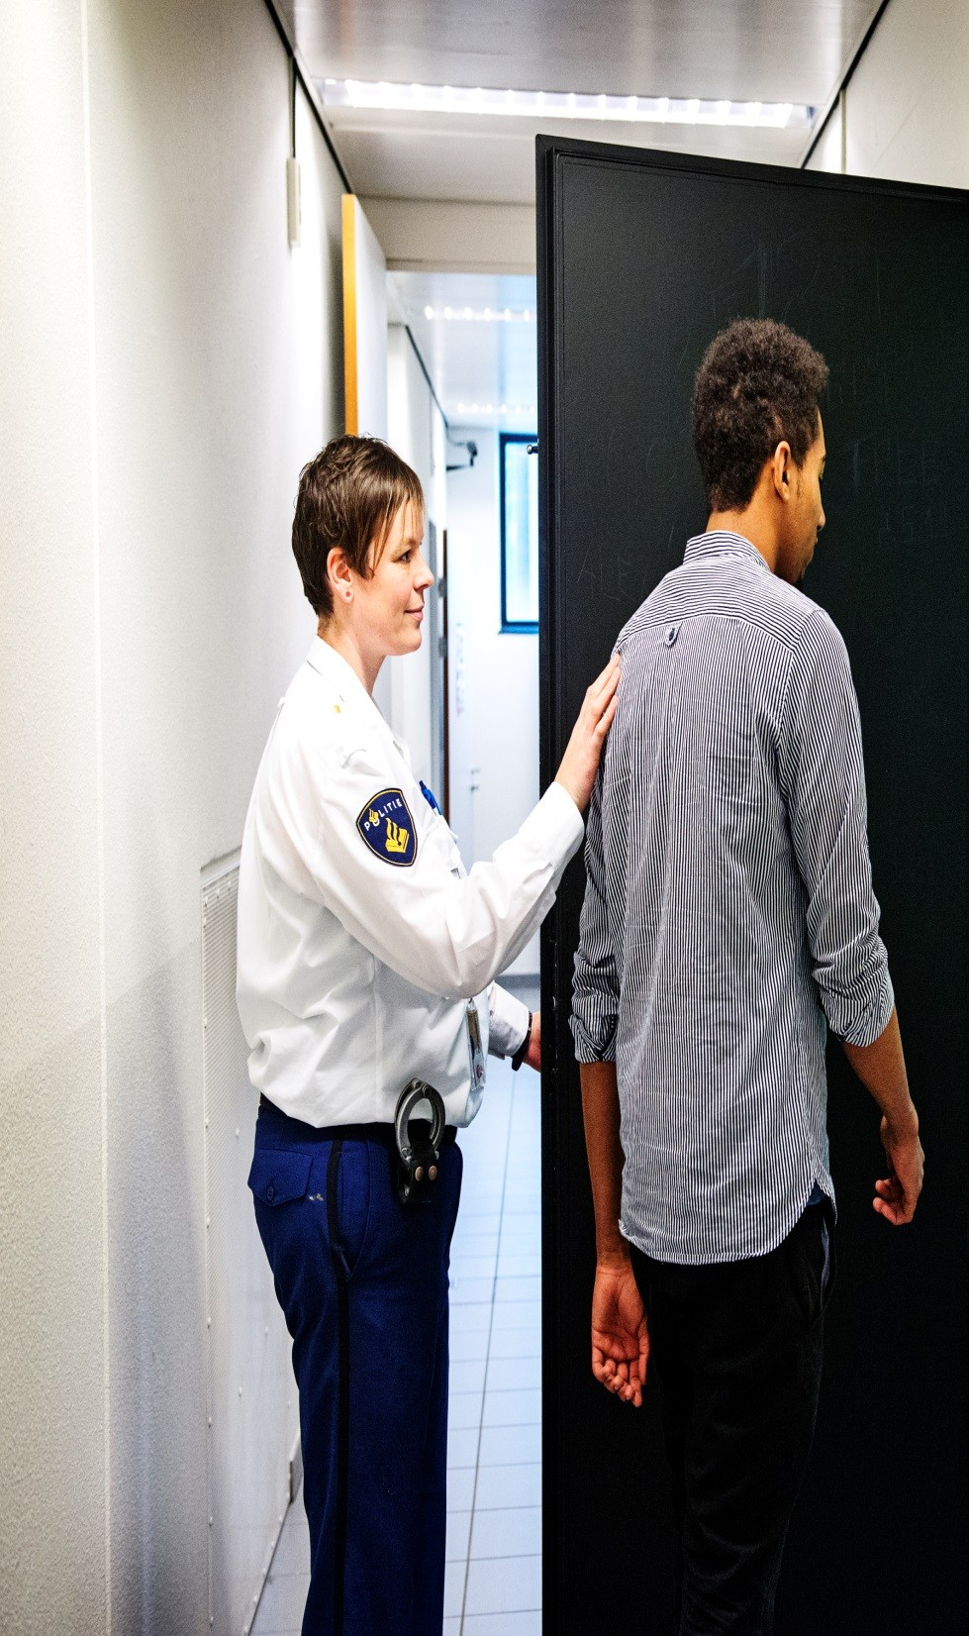
Part 4: Interrogation
CLICK on this icon to return to this page
In the last part of the Module, we deal with the right to effective lawyer’s participation during an interrogation.
The right is covered by the Directive on the Right of Access to a Lawyer, Article 3 (3) b: right to effective assistance of a lawyer during interrogation.
Click on the button to know more
Effecitve participation
Scenario

Slide 88
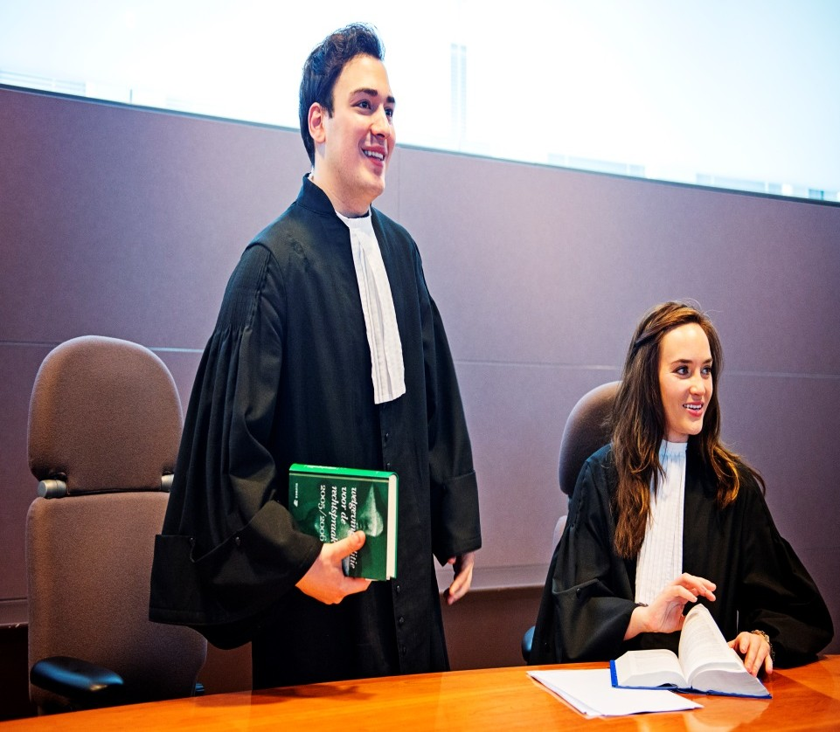
Part 4: Interrogation
The lawyer’s role during interrogation is not limited to passive presence. According to the Directive, lawyers should be able to ask questions, request clarification and make statements, in accordance with the procedures under national law regulating the participation of a lawyer during questioning of a suspect. These procedures should not prejudice the effective exercise and the essence of the defence rights.
How should one interpret this provision?
Active role of a lawyer
National procedures
Click on the numbers below to know more
1 2

Slide 89
Part4: Interrogation
The answer follows from the case law of the European Court of Human Rights and the international regulations on the role of a lawyer in criminal proceedings.
The Havana Declaration on the Basic Principles on the Role of Lawyers defines the
role of a lawyer as “advise clients on their legal rights and obligations and the working of the justice system” and “assist clients in every appropriate way.”
It also states that lawyers should “protect and establish their clients’ rights” and “defend them at all stages of criminal proceedings.”
Active role of a lawyer
National procedures
Click on the numbers below to know more
1 2

Slide 90
Part 4: Interrogation
It follows from the ECtHR case law that the lawyer’s role during suspect interrogation is to:
Protect suspects from torture, ill-treatment and improper compulsion
Help suspects understand their procedural rights, and assist them to exercise these rights
Provide emotional support to suspects (Dayanan v. Turkey), and, importantly
Help suspects to mount an effective defence against the accusation.
Active role of a lawyer
National procedures
When you have finished reading, click on the boxes on the left-hand side
1 2

Slide 91
Part 4: Interrogation
It
The last aspect was stressed in Salduz v Turkey and Pishchalnikov v Russia. There, the
follows from the ECtHR case law that the
wyer’s role during suspect interrogation is to:
Protect suspects from torture, ill-treatment and improper compulsion
Help suspects understand their procedural rights, and assist them to exercise these rights
Provide emotional support to suspects (Dayanan v. Turkey), and, importantly
Help suspects to mount an effective defence against the accusation.
Active role of National
a lawyer procedures
hen you have finished reading, click on the
_{la} Court said that the assistance of a lawyer helps to ensure the equality of arms between
the suspect and the investigative authorities, by giving suspects an opportunity to defend
against the criminal charge.
•
In the Aras v Turkey (no.2) case, the European Court of Human Rights found that the
right to legal assistance was violated, inter alia, because the applicant’s lawyer was only allowed to enter the interrogation room, but was not allowed to consult the applicant in private, or to take the floor and defend him.”
•
This effectively means that the European Court of Human Rights envisages an active role for a lawyer during suspect interrogations, including the possibility to influence the factual outcome of the interrogation .A lawyer may do so, for example, by advising clients about whether or not to respond to certain questions, assisting them to provide their accounts, suggesting new lines of inquiry, and bringing in information favorable to their clients.
•
W
boxes on the left-hand side
1 2

Slide 92
Part 4: Interrogation
It
The last aspect was stressed in Salduz v Turkey and Pishchalnikov v Russia. There, the
follows from the ECtHR case law that the
wyer’s role during suspect interrogation is to:
Protect suspects from torture, ill-treatment and improper compulsion
Help suspects understand their procedural rights, and assist them to exercise these rights
Provide emotional support to suspects (Dayanan v. Turkey), and, importantly
Help suspects to mount an effective defence against the accusation.
Active role of National
a lawyer procedures
hen you have finished reading, click on the
_{la} Court said that the assistance of a lawyer helps to ensure the equality of arms between
the suspect and the investigative authorities, by giving suspects an opportunity to defend
against the criminal charge.
•
In the Aras v Turkey (no.2) case, the European Court of Human Rights found that the
right to legal assistance was violated, inter alia, because the applicant’s lawyer was only allowed to enter the interrogation room, but was not allowed to consult the applicant in private, or to take the floor and defend him.”
•
This effectively means that the European Court of Human Rights envisages an active role for a lawyer during suspect interrogations, including the possibility to influence the factual outcome of the interrogation .A lawyer may do so, for example, by advising clients about whether or not to respond to certain questions, assisting them to provide their accounts, suggesting new lines of inquiry, and bringing in information favorable to their clients.
•
W
boxes on the left-hand side
1 2

Slide 93
P of the defence rights”?
Which national procedures are compatible with the “effective exercise and the essence
art 4: Interrogation
follows from the ECtHR case law that the wyer’s role during suspect interrogation is to:
Protect suspects from torture, ill-treatment and improper compulsion
Help suspects understand their procedural rights, and assist them to exercise these rights
Provide emotional support to suspects (Dayanan v. Turkey), and, importantly
Help suspects to mount an effective defence against the accusation.
Active role of National
a lawyer procedures
When you have finished reading, click on the oxes on the left-hand side
These are, for example, the requirement that a lawyer should respect the order and It procedure of the questioning, and that he should not obstruct the interrogation. la Obstructing the interrogation means behaving in such a way that prevents the police from
pursuing the interview, as long as it is fair and not oppressive.
•
These provisions should not be interpreted or applied to prevent lawyers from exercising
their legitimate functions during the questioning. These are, for example: advising clients, including to remain silent, asking a time-out for a confidential consultation, or challenging questions or lines of questioning that imply coercion, manipulation, are suggestive, or simply unclear.
•
A conflict situation may arise when a lawyer advises a client to remain silent following
(almost) every question, which in the officer’s view prevents him from pursuing an interview. The officer may believe that the client is inclined to give an answer, and he may perceive the lawyer’s behavior as obstructive. It is however, a legitimate function of the lawyer to advise his client at any time during the questioning. It should also be presumed that the lawyer acts in accordance with his client’s will and his best interest. For example,
_{b} the client may be highly suggestible, and the lawyer may be trying to protect him from giving self-incriminating answers.
1 2

Slide 94
P of the defence rights”?
Which national procedures are compatible with the “effective exercise and the essence
art 4: Interrogation
follows from the ECtHR case law that the wyer’s role during suspect interrogation is to:
Protect suspects from torture, ill-treatment and improper compulsion
Help suspects understand their procedural rights, and assist them to exercise these rights
Provide emotional support to suspects (Dayanan v. Turkey), and, importantly
Help suspects to mount an effective defence against the accusation.
Active role of National
a lawyer procedures
When you have finished reading, click on the oxes on the left-hand side
These are, for example, the requirement that a lawyer should respect the order and It procedure of the questioning, and that he should not obstruct the interrogation. la Obstructing the interrogation means behaving in such a way that prevents the police from
pursuing the interview, as long as it is fair and not oppressive.
•
These provisions should not be interpreted or applied to prevent lawyers from exercising
their legitimate functions during the questioning. These are, for example: advising clients, including to remain silent, asking a time-out for a confidential consultation, or challenging questions or lines of questioning that imply coercion, manipulation, are suggestive, or simply unclear.
•
To prevent conflicts in the interrogation room,
_{A conflict situation may a} lawyers may wish to discuss with the interrogating _{silent following}
rise when a lawyer advises a client to remain
which in the officer’s view prevents him fro believe that the client is inclined to give an answ vior as obstructive. It is however, a legitimate at any time during the questioning. It should als ordance with his client’s will and his best interes uggestible, and the lawyer may be trying to pr
officers how they define the boundaries of their _{m pursuing an}
(almost) every question,
legitimate role, before the start of the interview.
^{interview. The officer may} If a conflict nonetheless arises, lawyers may wish to ^{er, and he may} perceive the lawyer’s beha explain the reasons for their interventions to the function of the lawyer to advise his client interrogating officer(s) by reference to their o be presumed
that the lawyer acts in acc professional
role (if necessary, in a
private t. For example,
otect him from
_{b} the client may be highly s ^{conversation).}
giving self-incriminating answers.
1 2
Return to “Interrogation”

Slide 95
Interrogation
Read the case facts, watach the video, and then respond to the QUESTIONS
Peter is a co-suspect of Jacques, suspected of drug dealing. He was arrested at the State of Trance concert, after having been seen passing plastic bags with what looked like ecstasy pills to Jacques by two police informants.
CLICK below to watch the video
Peter is being interrogated in the presence of his lawyer M. The lawyer has not had been told about, or shown, the evidence before the start of the interrogation.
Please note that it is a simulated interrogation situation, and it may be different to what you are used to in your own practice.
QUESTIONS

Slide 96
Questions on the Scenario:
1
2
3
4
5
6
Interrogation
(CLICK on the numbers on the left-hand side)

Slide 97
Did Peter enjoy the right to lawyer’s effective assistance at interrogation?
1
2
3
4
5
6

Slide 98
Peter did not enjoy the right to effective legal assistance. The lawyer should have intervened more forcefully when pressure tactics were being used by the officer. A number of occasions during the interrogation called for a private consultation between the lawyer and the suspect, which the lawyer should have asked/insisted upon. Likewise, the interrogating officer breached Peter’s right to enjoy effective legal assistance by dismissing a legitimate lawyer’s intervention.
1
2
3
4
5
6

Slide 99
At which point during the interrogation should the lawyer have intervened for the first time, and why?
1
2
3
4
5
6

Slide 100
1
2
3
4
5
6
he lawyer could have intervened already in the beginning/before the start of the interrogation to state explicitly what her role is, and to reassure her client. Furthermore, the way in which the officer explained the right to remain silent (”you are not obliged to respond to my questions today”) is inappropriate. The lawyer may have reinforced the caution by stressing that it is the right of the suspect to remain silent.

Slide 101
What should the lawyer have done when the officer informed the suspect that “there are two witness statements against him”?
1
2
3
4
5
6

Slide 102
It is the lawyer’s role to advise a client at any point of the interrogation. Furthermore, the suspect and the lawyer have the right of access to the material evidence to enable effective legal assistance. Thus, the lawyer should have requested access to the witness statements, and, in any case, asked for a private consultation with the client to discuss the possible changes in the defence strategy, whether or not such access has been granted. (Denial to grant access would have been another reason to reinforce advice to remain silent).
1
2
3
4
5
6
Return to homepage

Slide 103
Module summary
In this module we have:
learned about how various
procedural
rights derived from the EU procedural rights’ Directives, case law of the ECtHR, and other international instruments apply at the stage of police detention;
reflected on how lawyers could use this knowledge in guiding their actions during problematic situations encountered when assisting suspects in police custody.
We have also learned that it is often the lawyer’s responsibility to actively enforce and protect the procedural rights of their clients.

Slide 104
Module summary
In this module we have:
learned about how various
procedural
rights derived from the EU procedural rights’ Directives, case law of the ECtHR, and other international instruments apply at the stage of police detention;
reflected on how lawyers could use this knowledge in guiding their actions during problematic situations encountered when assisting suspects in police custody.
In the literature section, you will find the
We have also learned
that it is often the
actively enforce and ghts of their clients.
_{lawyer’s responsibility to} instruments referred to in this module, as
_{protect the procedural ri} well as further readings on how procedural
rights apply at the police detention stage, and on the lawyer’s role in this regard.
LITERATURE

Slide 105
EU REGULATIONS:
Directive 2013/48/EU on the right of access to a lawyer in criminal proceedings
Directive 2010/64/EU on the right to translation and interpretation in cirminal proceedings Directive 2012/13.EU on the right to information in criminal proceedings
ECtHR CASE LAW:
Aras v. Turkey (no. 2) A. T. v. Luxembourg Dayanan v. Turkey Dvorski v. Croatia
Ibrahim and others v. UK Pishchalnikov v. Russia Salduz v. Turkey
OTHER INSTRUMENTS:
UN Basic Principles on the Role of Lawyers (Havana Declaration)
Next

Slide 106
ADDITIONAL LITERATURE:
Fair Trials International Toolkit on the Directive on the right of access to a lawyer
Fair Trials International Toolkit on the Directive on the right to interpretation and translation Fair Trials International Toolkit on the Directive on the right to information
Fair Trials International Toolkit on using EU law in practice
CLOSE

